Slide 1
Employee Data Analysis using Excel
STUDENT NAME : RAGAVAN.R
REGISTER NO : 312211520, DF3E38F855C48D9B73B44EA73E840519
DEPARTMENT : BACHELOR OF COMMERCE
COLLEGE : THIRUTHANGAL NADAR COLLEGE

Slide 2

PROJECT TITLE
Employee Performance Analysis using Excel

Slide 3


AGENDA
Problem Statement
Project Overview
End Users
Our Solution and Proposition
Dataset Description
Modelling Approach
Results and Discussion
Conclusion
3/21/2024 Annual Review

Slide 4

PROBLEM STATEMENT
The analysis helps in making informed decisions regarding training needs, promotions, and overall workforce optimization.

Slide 5

PROJECT OVERVIEW
This project aims to analyze workforce data to uncover trends in performance, retention and satisfaction. By analyzing various employee metrics such as demographics, performance reviews tenure and turnover.

Slide 6


WHO ARE THE END USERS?
•Human Resources (HR) Managers:
•Department Managers/Supervisors:
•Senior Management/Executives:
•Employees:

Slide 7

OUR SOLUTION AND ITS VALUE PROPOSITION Conditional formatting -Highlight blanks Filter -Remove blanks Formula -Performance analysis Pivot table -Summarize information Graph –Data visualization

Slide 8

Dataset Description Employee Dataset - From Edunet Dashboard Available Features - 26 Necessary Features- 9 Employee Id - In Number Name - In text Performance Level – In text Gender - Male, Female Employee Rating - In Numerical value

Slide 9

THE "WOW" IN OUR SOLUTION
Performance Level Analysis=IFS(Z8>=5,”VERY HIGH”,Z8>=4,”HIGH”,Z8>=3,“MED”,TRUE,”LOW”)
3/21/2024 Annual Review
‹#›

Slide 10

MODELLING
Charts
•Purpose: To visualize the data in an easily interpretable format, making trends and patterns more apparent.
•Implementation: Various types of charts (e.g., bar charts, line charts, pie charts) will be created based on the pivot table outputs. For instance, a line chart could show the trend of an employee's productivity over time, while a bar chart could compare performance across different departments.
4. Conditional Formatting
•Purpose: To highlight specific data points that meet certain conditions, making it easier to spot trends, outliers, or areas of concern.
•Implementation: Conditional formatting will be applied to cells based on rules, such as highlighting cells in red if an employee's performance falls below a certain threshold, or in green if targets are exceeded. This immediate visual cue helps in quickly identifying critical areas needing attention.
‹#›

Slide 11
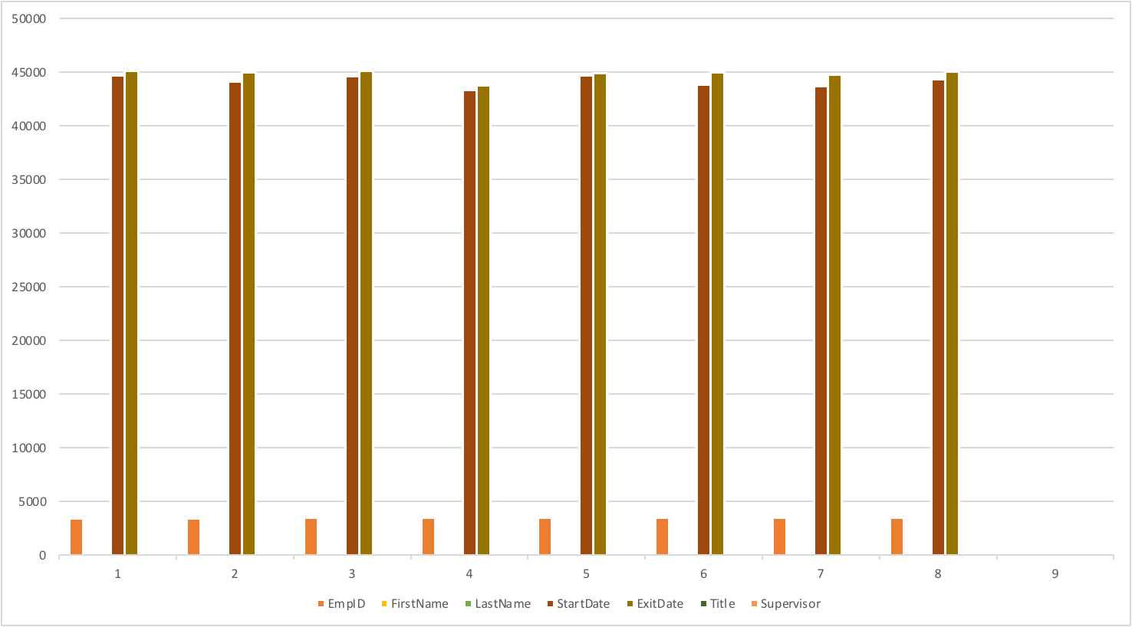

Result
‹#›

Slide 12

Conclusion Employee performance analysis ,most of the employees fall within the medium performance range. A smaller group of employees shows high performance , while very few fall into the low or very high performance categories. This suggest a need to focus on elevating medium performers to high performers while addressing the factors that contribute to low performance. From this Employee performance analysis ,most of the employees fall within the medium performance range. A smaller group of employees shows high performance , while very few fall into the low

